Slide 1
AWS CERTIFIED CLOUD PRACTITIONER TRAINING
By: Muhammad Ahmad

Slide 2

How websites work?
Clients and servers have IP addresses.

Slide 3



What is a server composed of?
Compute: CPU
Memory: RAM
Storage: Data
Database: Store data in a structured way

Slide 4
IT Terminology
How Internet works?
Network: cables, routers and servers connected with each other
Router: A networking device that forwards data packets between computer networks. They know where to send your packets on the internet!
Switch: Takes a packet and send it to the correct server / client on your network

Slide 5
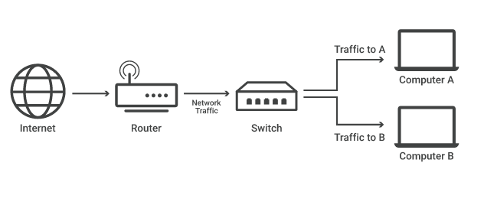

Slide 6
Why Cloud Computing?
Cloud computing is used in replace to traditional approach
Traditionally, we use on-premises approach in which we are developing applications as well as infrastructure.
We have to face some problems with traditional approach
Scaling is limited
Hire 24/7 team to monitor the infrastructure
How to deal with disasters? (earthquake, power shutdown, fire…)

Slide 7
What is cloud computing?
Cloud computing is the on-demand delivery of compute power, database storage, applications, and other IT resources
Through a cloud services platform with pay-as-you-go pricing
You can provision exactly the right type and size of computing resources you need
You can access as many resources as you need, almost instantly
Simple way to access servers, storage, databases and a set of application services

Slide 8
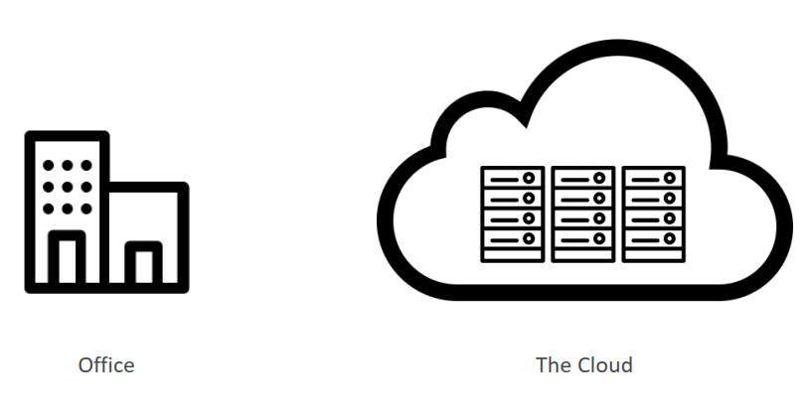

Slide 9

Some commonly used Cloud Services
Gmail Dropbox Netflix

Slide 10
The Deployment Models of the Cloud
Private Cloud
Cloud services used by a single organization, not exposed to the public
Complete control
Security for sensitive applications
Public Cloud
Cloud resources owned and operated by a thirdparty cloud service provider delivered over the Internet.
Hybrid Cloud
Private Cloud + Public Cloud

Slide 11
Six Advantages of Cloud Computing
Trade capital expense (CAPEX) for operational expense (OPEX)
Benefit from massive economies of scale
Stop guessing capacity
Increase speed and agility
Stop spending money running and maintaining data centers
Go global in minutes

Slide 12
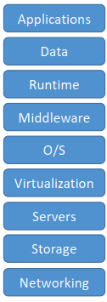
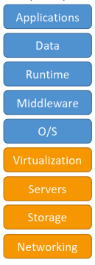
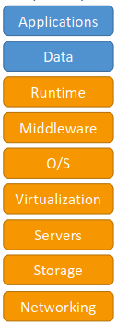
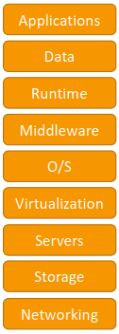

Types of Cloud Computing
On premises
Infrastructure as a service (IaaS)
Platform as a service (PaaS)
Software as a Service

Slide 13



Examples of Cloud Computing
Infrastructure as a service (IaaS):
Amazon EC2
Platform as a service (PaaS)
Elastic Beanstalk (on AWS)
Software as a Service
Many AWS services (ex: Rekognition for Machine Learning)

Slide 14
Pricing of the Cloud
AWS has 3 pricing fundamentals
Compute
Storage
Data Transfer OUT of the Cloud

Slide 15
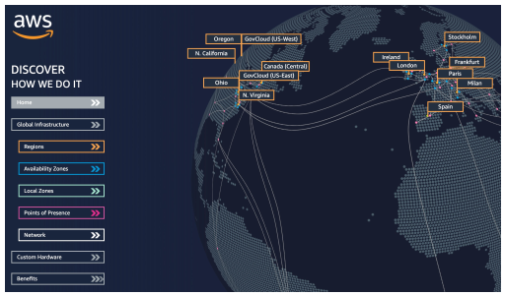
AWS Global Infrastructure
AWS Global infrastructure consists of
AWS Regions
AWS Availability Zones
AWS Data Centers
AWS Edge Locations / Points of Presence

Slide 16
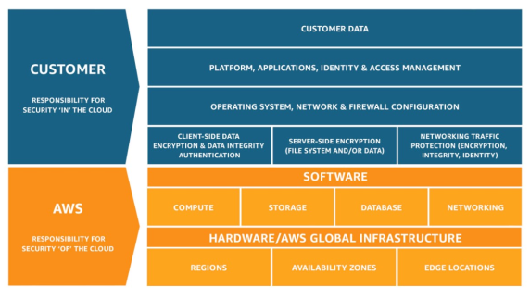
Shared Responsibility Model diagram
CUSTOMER = RESPONSIBILITY FOR
THE SECURITY IN THE CLOUD
AWS = RESPONSIBILITY FOR
THE SECURITY OF THE CLOUD

Slide 17
IAM SECTION

Slide 37
PowerPoint 2013
Intuitively design beautiful presentations, easily share and work together with others and give a professional performance with advanced presenting tools.
Find out more at the PowerPoint Getting Started Center
(Click the arrow when in Slide Show mode)
Notes:
In Slide Show mode, click the arrow to enter the PowerPoint Getting Started Center.

